Slide 1
Stanly County Comprehensive Transportation Plan (CTP) Overview
Temilope Animashaun, Roger Castillo
April 2, 2024

Slide 2
Today’s Agenda
Draft CTP Vision and Goals Wrap-up
Draft Goals and Objectives Survey Walkthrough
Discuss Survey Outreach
Informational Maps
Highway Crash
Bicycle and Pedestrian Crashes
Truck Percentage
Deficient Bridges
Identifying growth areas and destinations
Next Steps

Slide 3
Vision/Goals
Produce and maintain a Comprehensive Transportation Plan to preserve and promote the quality of life and economic vitality of Stanly County and all its municipalities. This will be accomplished by providing an accessible, integrated, efficient, safe, and environmentally responsible multi-modal transportation system.
Preserve, protect, and enhance the natural and human environment.
Improve the safety, connectivity, and mobility of the transportation system, for people and freight, for all modes of transportation in and through the region.
Maintain and enhance the quality and performance of the transportation system in Stanly County through efficient congestion management and operations techniques.
Promote and enhance connectivity and mobility throughout Stanly County and the surrounding region and metropolitan areas.
Improve the security of the transportation system in Stanly County for all modes and users.
Encourage preservation of scenic views and rural character.
Provide an adequate transportation network and infrastructure for the agricultural industry.

Slide 4
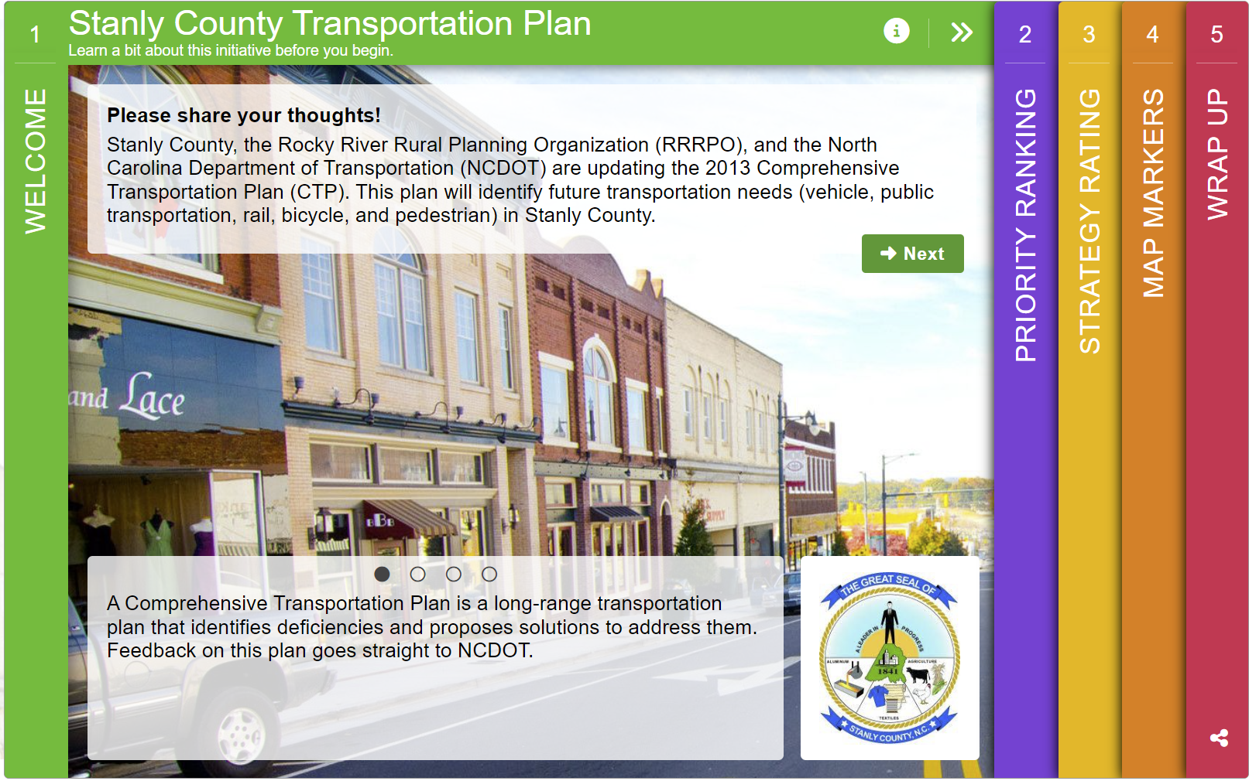
Goals and Objectives Survey
Things to consider:
Are there any specific questions we want to ask?
Any specific location we want public feedback on?
How do we want to distribute these?
Flyers
Methods of distribution
Locations
Stores
Draft Survey Demo Link:
https://demo.metroquestsurvey.com/en2z2f

Slide 5
Informational Maps
Planning level maps that represent the transportation network in the Base Year (2022)
Crash Frequency – Displays the number of crashes in Stanly County (Years 2018 - 2022)
Crash Severity – Displays the number for serious or fatal crashes in Stanly County (Years 2018 – 2022)
Bike and Ped Crashes – Show locations of vehicle crashes with cyclists or pedestrians (Years 2018-2022)
Truck Traffic – Displays percent truck and the average trucks that pass each day throughout the year
Bridge Deficiency – Displays the locations of deficient bridges

Slide 6
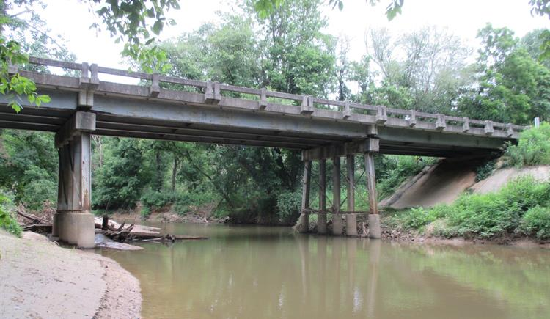
Deficient Bridge Map
This does not imply that they are likely to collapse or are unsafe
Structurally Deficient
Bridge must be monitored, inspected, repaired/replaced to maintain structural integrity
Functionally Obsolete
Bridge built to standards that are not used today
May not have adequate lane widths, shoulder widths, vertical clearances, etc.
98 Bridges in Stanly County
11 Bridges are either Structurally Deficient or Functionally Obsolete along the Study Roads (20 Total)

Slide 7
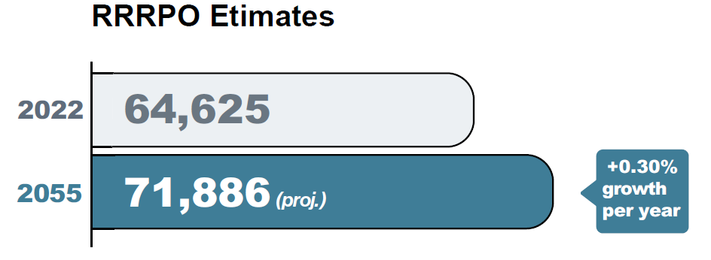
Stanly County Trends
Year | 2020 | 2022 | 2025 | 2030 | 2035 | 2040 | 2045 | 2050 | 2055 | 2060 | 2065
Population | 62,504 | 64,625 | 66,747 | 68,253 | 69,172 | 69,759 | 70,474 | 71,188 | 71,886 | 73,287 | 74568
Employment | 10264 | 10531 | 10799 | 11344 | 11511 | 11481 | 11463 | 11441 | 11502 | 11596 | 11682
This data was approved by the Rocky River RPO TAC in November 2023

Slide 8
Planning for the Future
What type of new development is planned in the County? (ex. New businesses, relocations, improvements)
What are some highly trafficked areas? (tourism, seasonal, large county event locations)

Slide 9
Contacts
Anson County CTP
NCDOT Transportation Planning Division (TPD)
Temilope Animashaun, tmanimashaun@ncdot.gov, (919)-707-0931 (Project Engineer)
Roger Castillo, ricastillo@ncdot.gov, (919) 707-0942 (Project Engineer)
Rocky River Rural Planning Organization (RPO)
Lee Snuggs, lsnuggs@rockyriverrpo.org, (704) 986-3871

Slide 10
QUESTIONS

